Slide 1
PUC Creo Challenge Fall 2015
Challenge-Using Graph Features
Your company, Eastern Glass Platform Co., has a contract to build a cantilevered all-glass walkway sticking out from the side of this mountain.

Slide 2
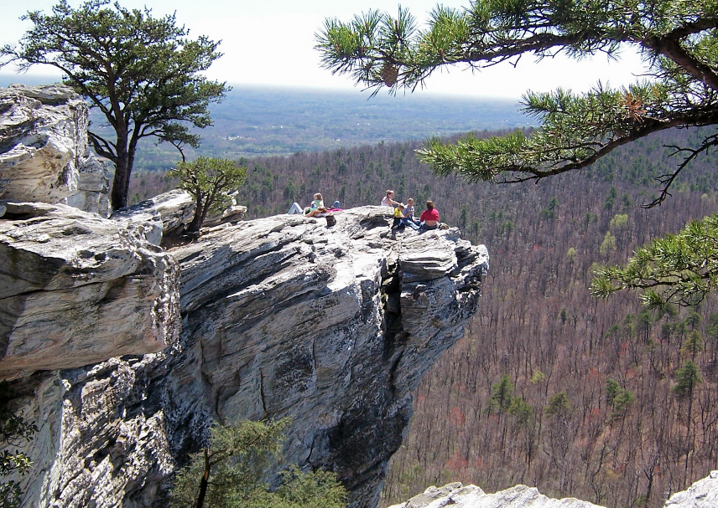
PUC Creo Challenge Fall 2015

Slide 3
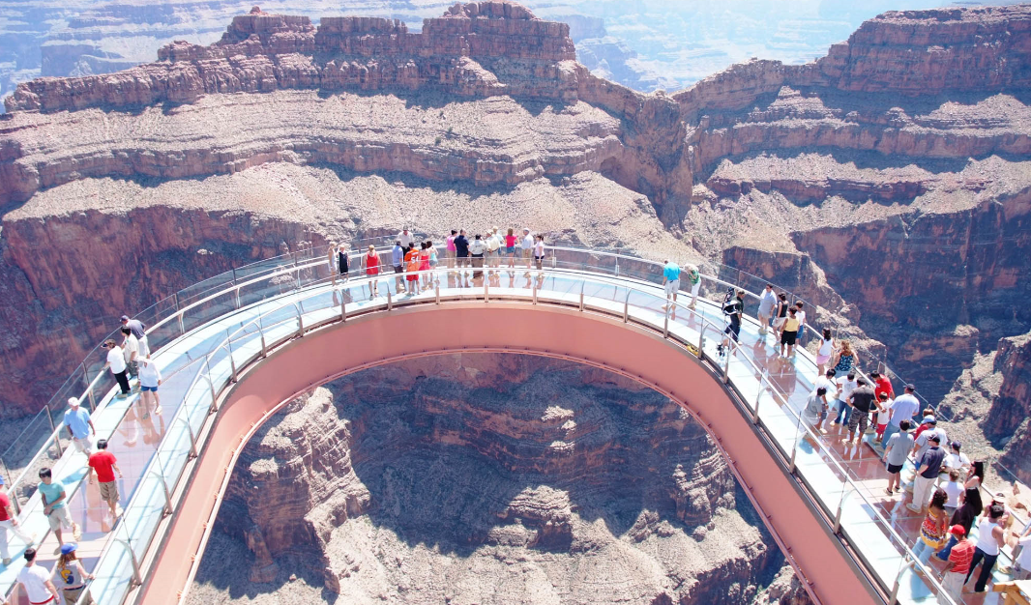
PUC Creo Challenge Fall 2015

Slide 4
PUC Creo Challenge Fall 2015
The Engineer…
…thought it should look like this: (Side View…straight, not a “U”)
…because, hey, it’s a beam, right?
Attached End Free End

Slide 5
PUC Creo Challenge Fall 2015
The Art Director (Armani )…
…thought, sure but the bottom profile should look like this: (Side View)
Attached End Free End

Slide 6
PUC Creo Challenge Fall 2015
The Purchasing Manager…
…thinking about how many pounds of glass he was going to have to buy, thought it should look like this:(Side View)

Slide 7
PUC Creo Challenge Fall 2015
The Engineering Manager…
…quite surprisingly, was told that he must complete the design and
SATISFY EVERYBODY!
However
no visible holes allowed!

Slide 8
PUC Creo Challenge Fall 2015
So, you are the Creo Designer…
…what do you do?
Gather the facts (of course): Length: 48 ft
Minimum Width: 2 ft
Design Load: 7500 lb Glass strength: 12.5 kpsi

Slide 9
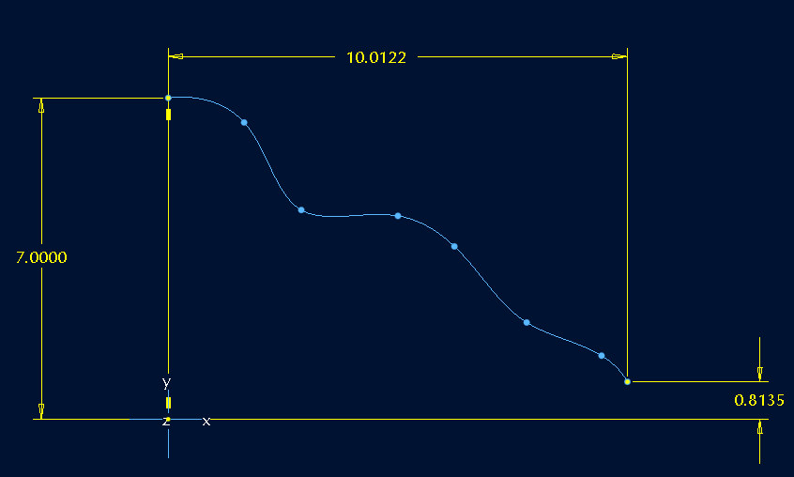
PUC Creo Challenge Fall 2015
Your task
Use Armani’s sketch of the bottom profile
Imported as
Graph1
…to drive your design while minimizing total weight

Slide 10
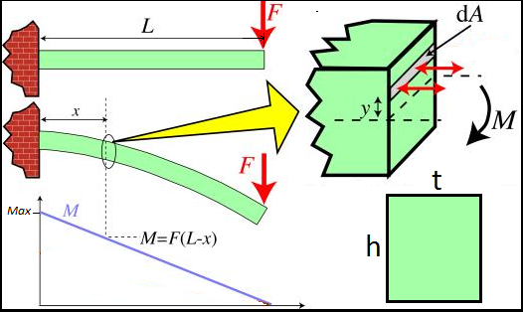
PUC Creo Challenge Fall 2015
Remember from Mechanics class
Bending Moment greatest at X=0

Slide 11
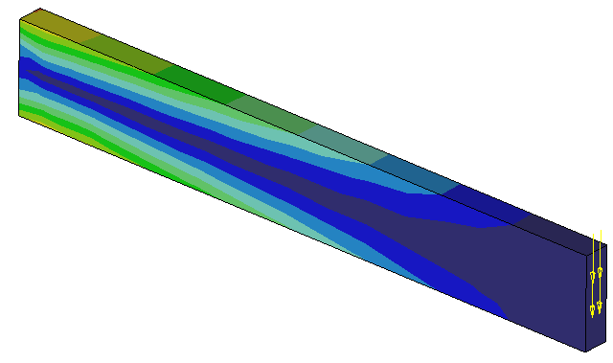
PUC Creo Challenge Fall 2015
Therefore, bending stress looks like this
Free End
Attached End
All the “Blue” areas have wasted material

Slide 12
PUC Creo Challenge Fall 2015
So, you will have to minimize the weight while satisfying the
MAX STRESS SPECIFICAION
This will be accomplished by controlling the thickness (t) with relations such that the bending stress is fairly constant

Slide 13
PUC Creo Challenge Fall 2015
Don’t worry, all the formulas will be provided…see below

Slide 14
PUC Creo Challenge Fall 2015
Therefore:

Slide 15
PUC Creo Challenge Fall 2015
and Simplifying:
This will be needed to control thickness for constant max stress

Slide 16
PUC Creo Challenge Fall 2015
You will need to use Section (not Part) Relations:
height=evalgraph("graph1",trajpar*10)
thickness=6 * F * (48-trajpar*48) (Max_stress * height²)

Slide 17
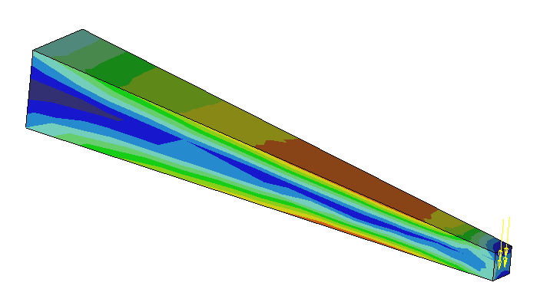
PUC Creo Challenge Fall 2015
HINT…
Less wasted “Blue” area

Slide 18
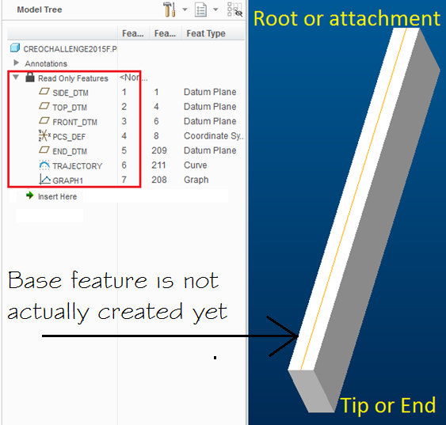
PUC Creo Challenge Fall 2015
Start with…
Already modeled this far…
Do not modify Read-Only features

Slide 19
PUC Creo Challenge Fall 2015
The assumptions
Armani’s profile sketch is a mirror image of the bottom…clearly the top walking surface is flat & horiz and flush to TOP_DTM.
The load is at the very end.
Gravity/self-weight not considered
Other than material, cost is not a factor (ie, don’t fret the mfg).

Slide 20
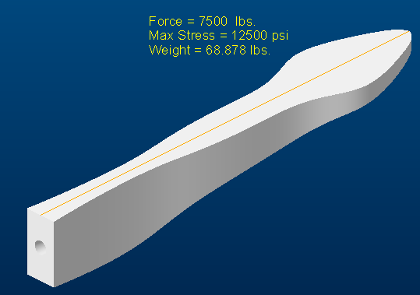
PUC Creo Challenge Fall 2015
How to do it…completed model here
Hmmm, very interesting shape

Slide 21
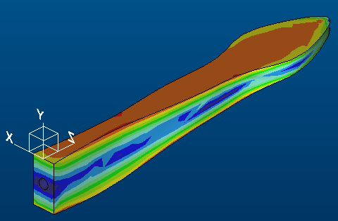
PUC Creo Challenge Fall 2015
Constant section, variable stress…
Note:
Model units are actually inches vs feet
To run FEA, change Units system to IPS prior to entering Simulation mode
…variable section, constant stress

