Slide 1
Pro/Users Fall Event 2016
Using Beam Elements in FEA
Gavin B. Rumble, PE Solid Engineering & Design
Background: 29+ yrs mechanical design & analysis
Creo, Wildfire, Pro/Engineer Pro/Mechanica MathCAD 2D CAD -
Consulting Process Layouts Equipment Specs Forensic & Predictive Analysis
Machine Design
Why aren’t you doing this presentation?
Yes, you do know enough about Pro/E to do this…and you would probably be better at it than me.
Think about it, and consider doing one this Spring (2017)
Remember, there is…
Cash and prizes for all presenters!!

Slide 2
Mechanical Engineers and Designers using PTC® products for:
Solid Engineering & Design
Machine Design
Industrial Automation
Test Lab Equipment
Food Processing
Heavy Equipment
Textile Machinery
Industrial Dryers
Product Design
Commercial Products
Consumer Products
Security Enclosures
Doors & Windows
Office Furniture
Vehicle Analysis
Stress Analysis

Slide 3
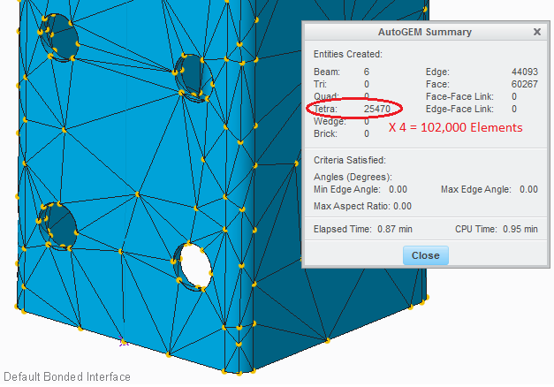
Design Model – Solid Elements

Slide 4
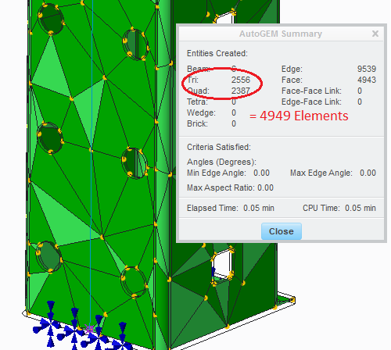
Analysis Model – Shell Elements

Slide 5
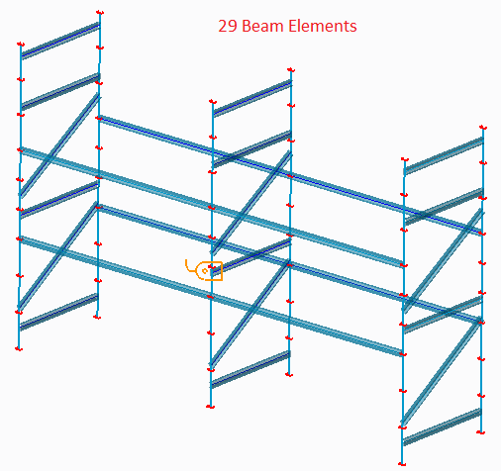
Analysis Model – Beam Elements

Slide 6
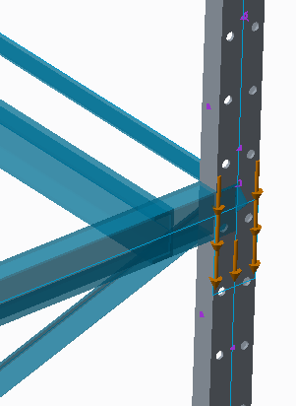
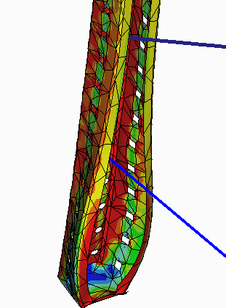
…or a Hybrid Model Beam and Shell Elements
Beam elements for total rack stability/stiffness, and a shell elements for local high stress determinations.

Slide 7
Fun with Beam Elements
Beam Elements can be one of several built-in cross section shapes or can be sketched for more complex shapes (weldments, for example)
Creo needs to know “where” on the cross section to evaluate and report stresses…these points are called:
Stress Recovery Points
Stress Reporting Points
Grid Points…depending on where you look. ☹
Review button…the coords shown are not sketch coords, Beam Section Coord Sys, but rather Beam Action Coord Sys.
IF YOU SKETCH A SECTION YOU HAVE TO ADD THEM IN ORDER TO OBTAIN ACCURATE STRESS RESULTS.

Slide 8
Car Wash Model
Images 1-4
Open Static2 model, no Stress Recovery Points
Open ta820002.prt, show 3 beam sections
Image 5

Slide 9
Fun with Beam Elements (cont’d)
BACS…set your Y-dir. X is always along the beam. RHR!
Beam elements respect the curve creation order (AB vs BA), but can be reversed or flipped (arrow or dialog). This is flipping the X-dir of the BACS.
Beam Releases…sort of like constraints at endpoints (6 DOF)
Applying loads…distributed versus point (you must plan ahead while creating sketch)
In Creo 3.0, you can show beams in Wireframe and Shaded.
You can turn off Mesh Points and Shrink elements (for us old timers) in Simulation Display.

Slide 10
Storage Rack Model
Open Rack1 – discuss curves and solid models
Beam Definition dialog:
References, Material, Y-Dir Orientation (nominal dir)
Beam Section, Beam Orientation, Beam Release

Slide 11
Hydraulic Straightener Model
Early Design material (tube?) validation
Very fast results

Slide 12
Hydraulic Straightener Model
Early Design material (tube?) validation
Very fast results
Marketing design change…they want a diff shape
Beam Elements are Very quick to model
Beam Elements provide Very fast results.

Slide 13
Any Questions…?
?
Notes and Outline will be posted on the Pro/Users of the Carolinas website

